Slide 1
Attack Trees
Risk, security and agile projects

Slide 2
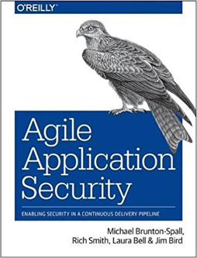
Michael Brunton-Spall
He/His/Him
https://tinyletter.com/cyberweekly
Notes:
What this talk is not – guide to do it, deep dive.
Instead Overview and context. Go and experiment

Slide 3
Attack Trees

Slide 4
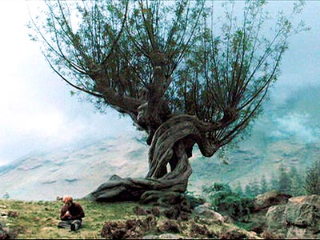

Slide 5
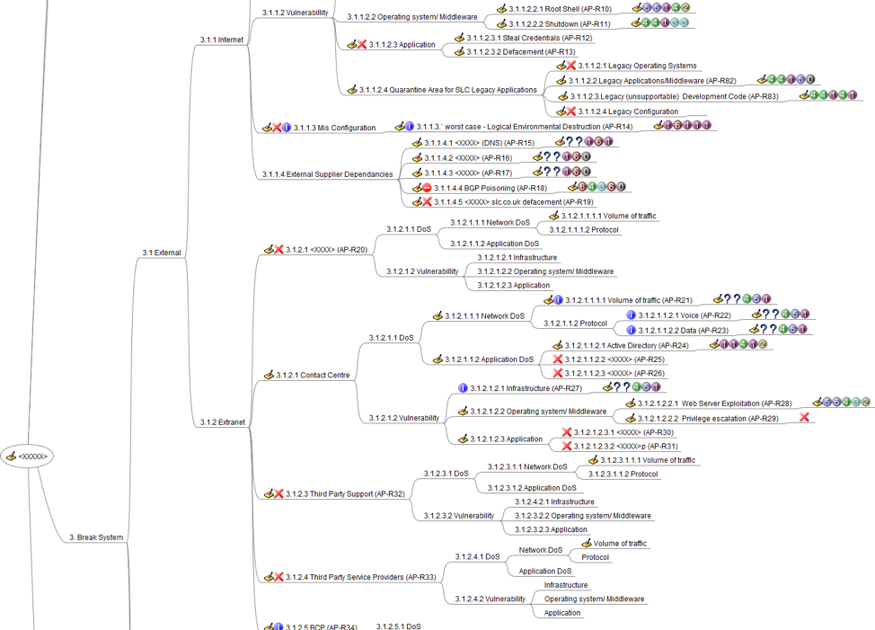

Slide 6
Introduction
Risk and security – Why?
Anti-Personas
Attack Trees
Countermeasures
Integrating with agile

Slide 7
What’s the problem?

Slide 8
Security and Risk

Slide 9
Traditional methods don’t really work

Slide 10
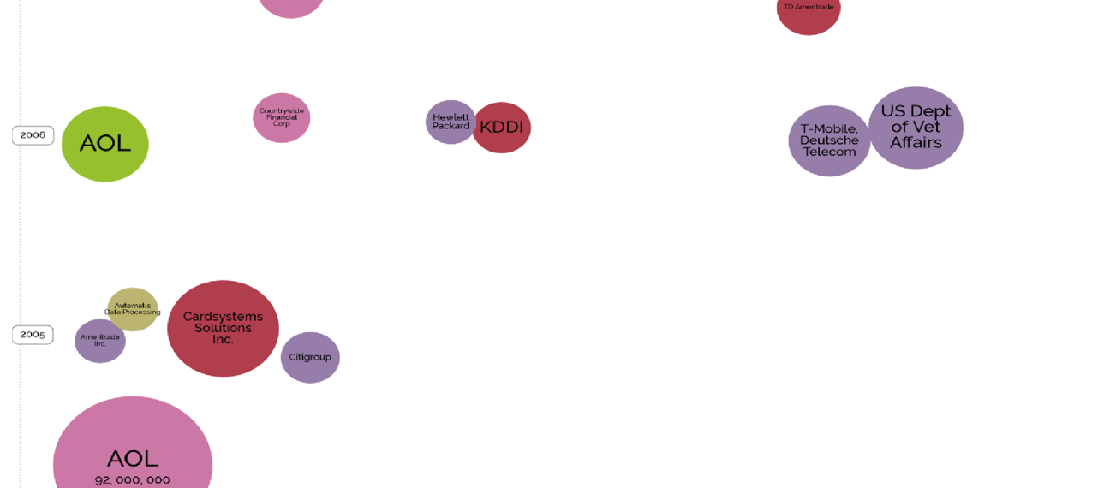
2006
Notes:
Green – Inside job
GRey – Accidentally published
Dark pink – Hacked
Purple – Lost or stolen
AOL 92m, sysadmin
Revenue and customs – lost cds

Slide 11
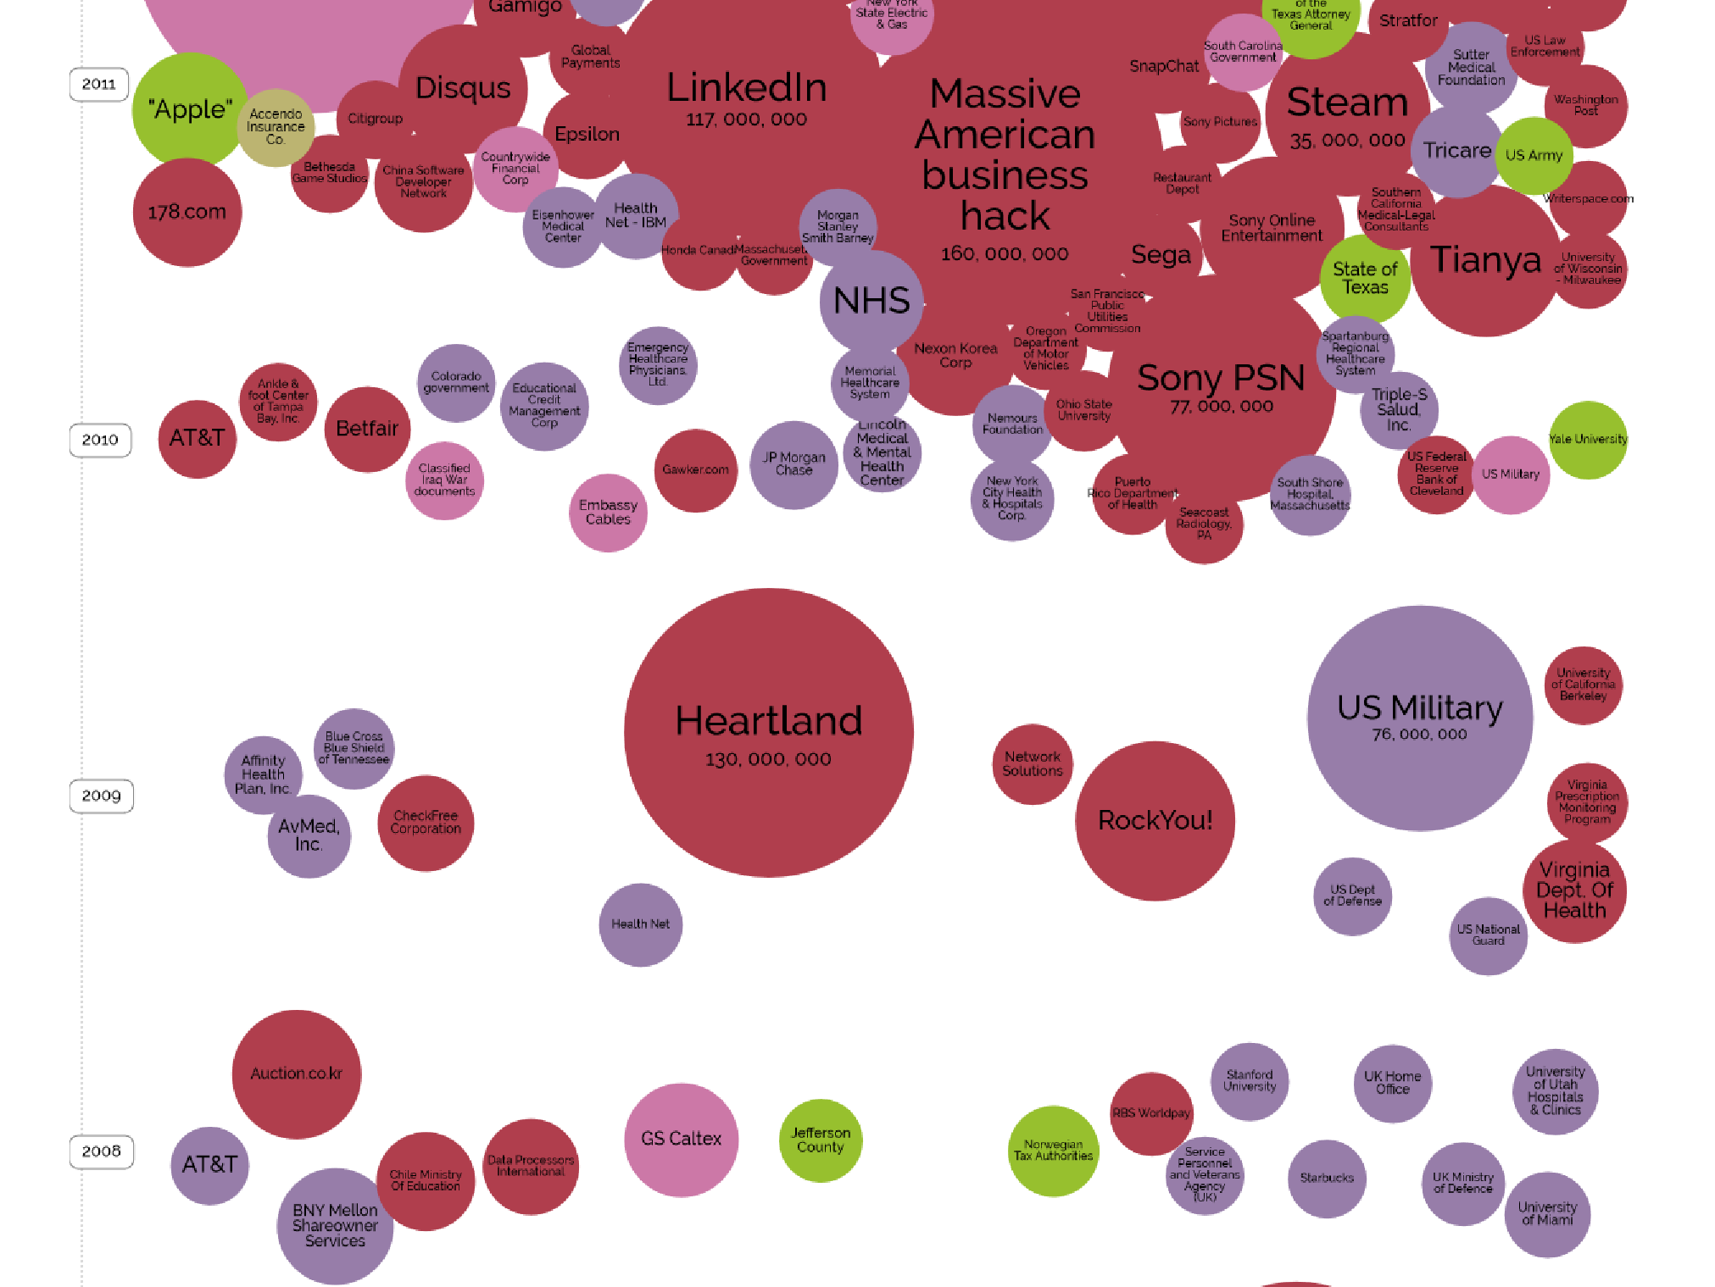
2010
Notes:
Sony PSN hack – 77m records – LulzSec
Linked In
Embassy Cables

Slide 12
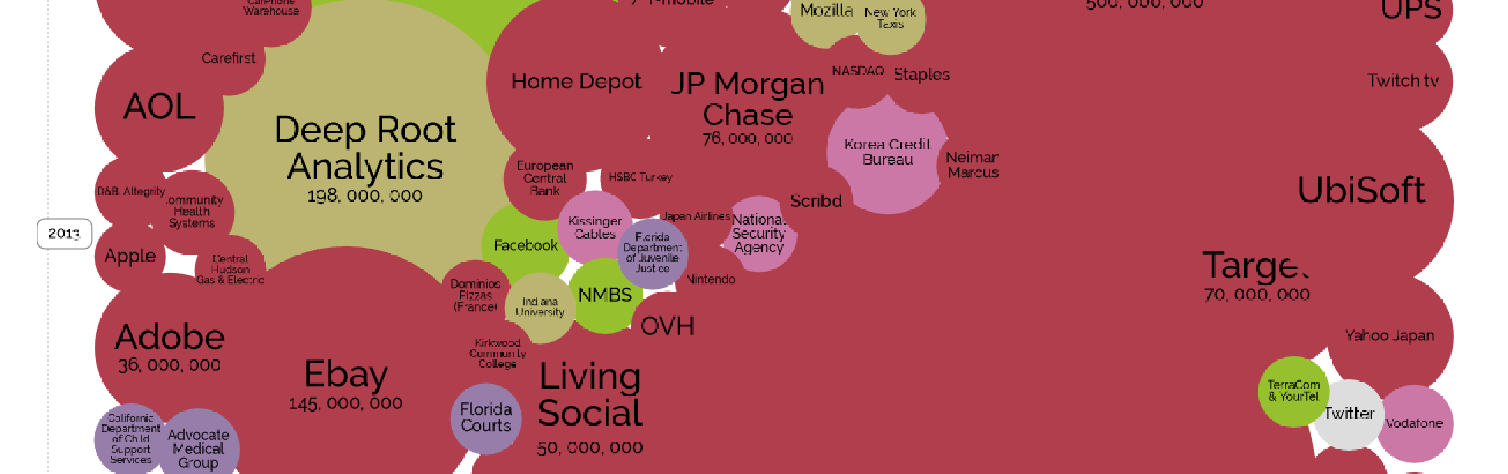
2013

Slide 13
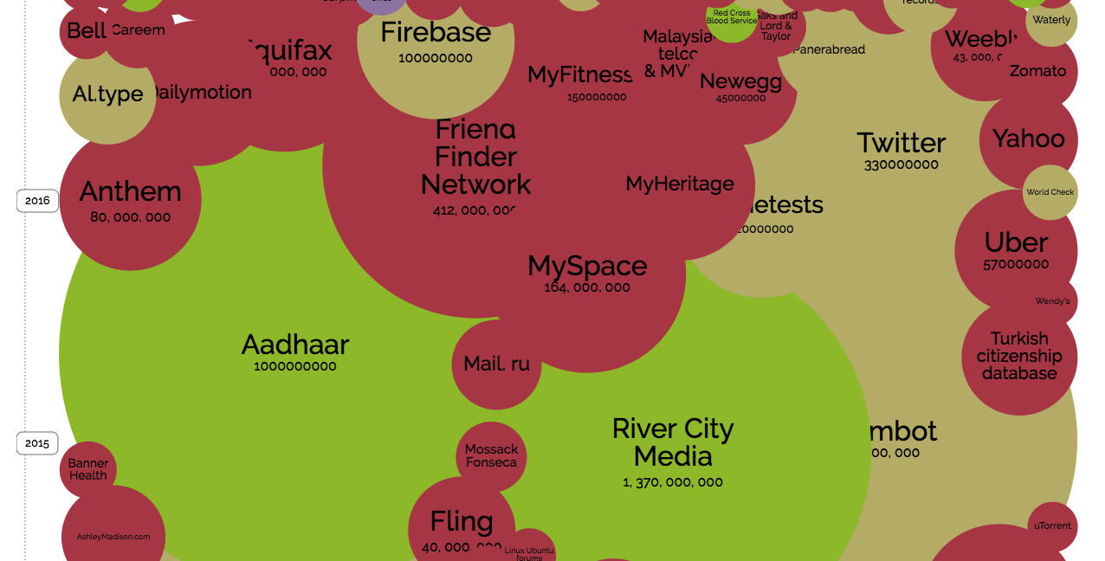
2018
2018
Notes:
Hong Kong – laptops went missing at backup venue for election. Laptops stolen from locked room, encrypted drives.
Aadhaar – Indian Biometric Database
Twitter, 330m account passwords stored in logs

Slide 14
PCI, ISO27001, SP-800-30

Slide 15
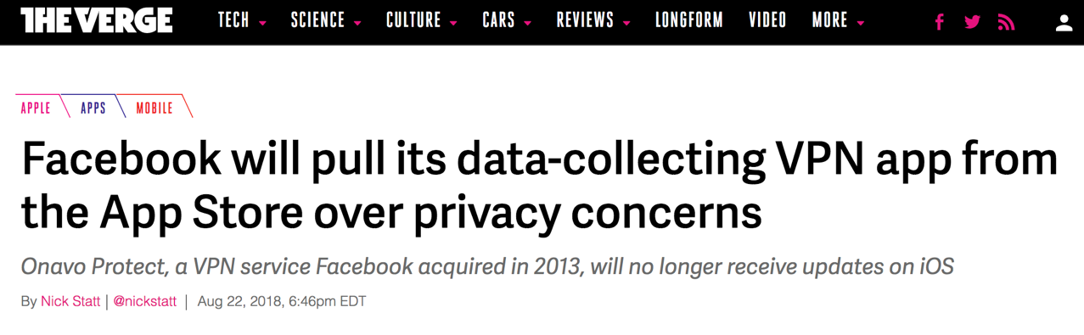
Notes:
Facebook collects data on VPNs

Slide 16
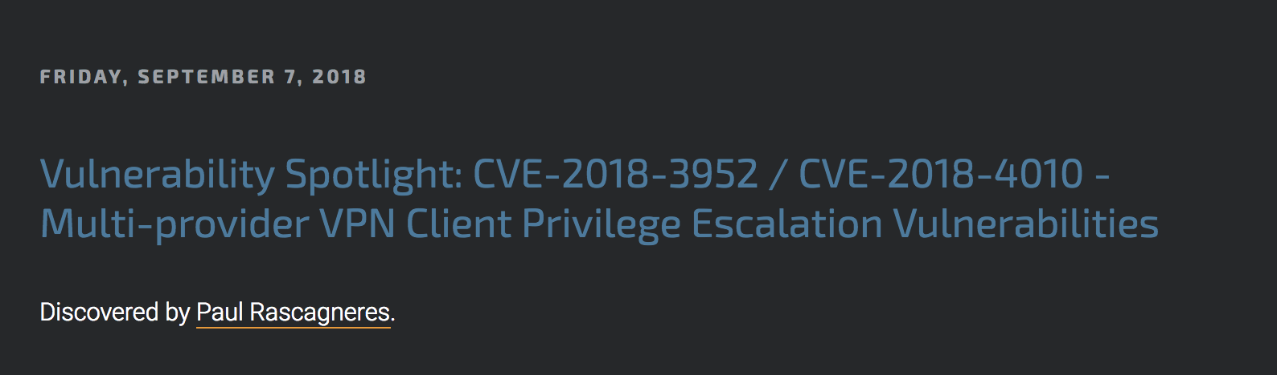
Notes:
Talos security found vulnerabilities in ProtonVPN and NordVPN clients

Slide 17
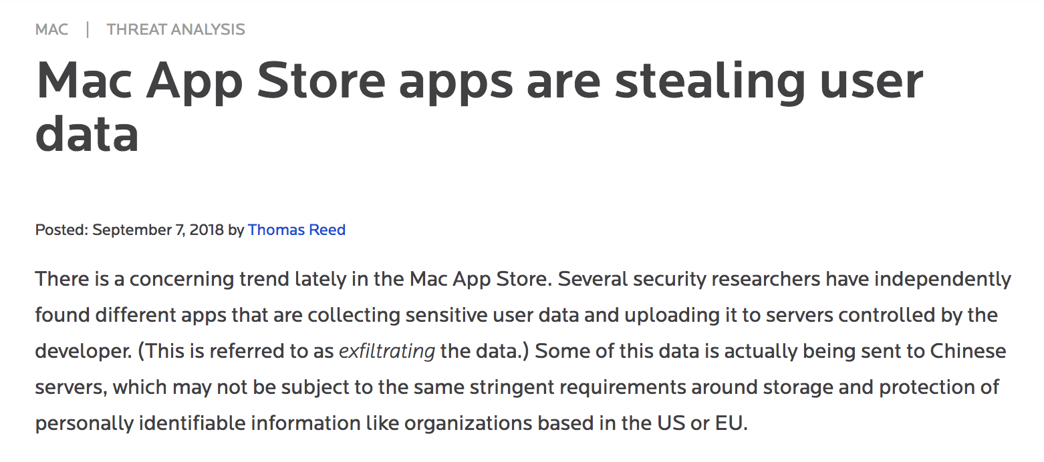
Notes:
Mac apps written by trendMicro

Slide 18
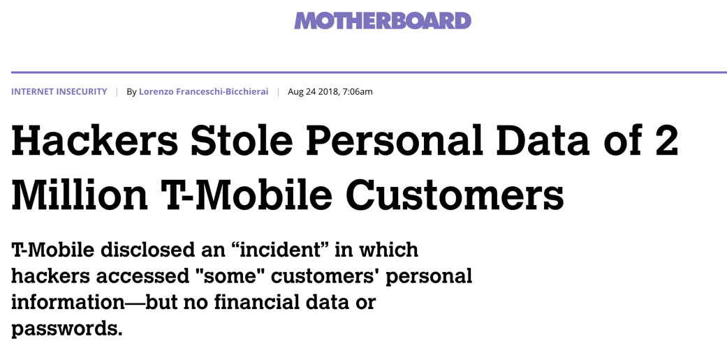
Notes:
T-Mobile

Slide 19
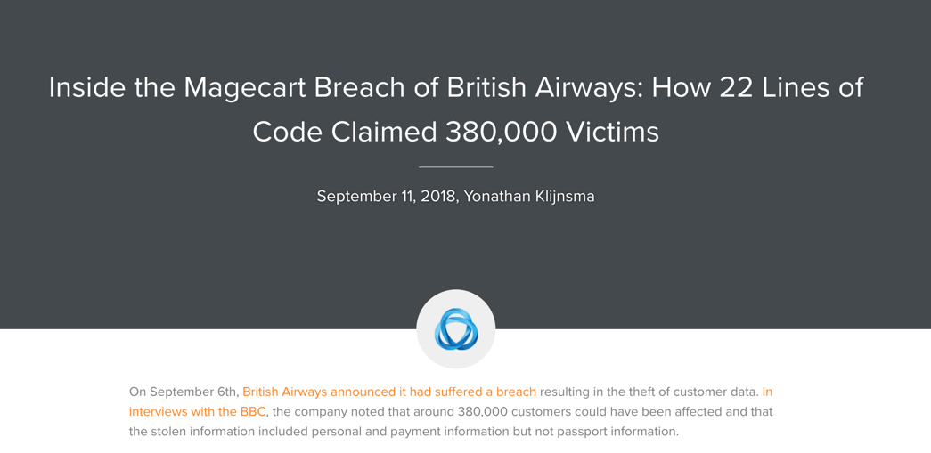
Notes:
British Airways
Approx £11b in revenues, estimated approx. £200m yearly IT budget (in 2010!)

Slide 20
Risk methodologies

Slide 21
Component based

Slide 22
IS1, ISO27005,
NIST SP-800-30

Slide 23
System based

Slide 24
TOGAF, SABSA, Attack Trees

Slide 25
Component Pro’s
Thorough, Exhaustive, Objective

Slide 26
Systemic – Pro’s
Subjective, Holistic, Interaction focused

Slide 27
Complexity theory

Slide 28
Simple Systems – A bike

Slide 29
Complicated systems – A car

Slide 30
Complex Systems - Traffic

Slide 31
Attack trees

Slide 32
Business needs
System Scope
Threats
Attack Tree Workshop

Slide 33
Attacker Goal:
Steal Documents from Safe in Bank

Slide 34
Get documents

Slide 35
Get documents
Open Safe
Steal from staff

Slide 36
Get documents
Open Safe
Steal from staff
Grab in transit
Hold up office

Slide 37
Get documents
Open Safe
Steal from staff
Break Safe
Get Combination
Grab in transit
Hold up office

Slide 38
Get documents
Open Safe
Steal from staff
Break Safe
Get Combination
Grab in transit
Hold up office
Where written down
Blackmail staff
Observe entry

Slide 39
Get documents
Open Safe
Steal from staff
Break Safe
Get Combination
Grab in transit
Hold up office
Where written down
Blackmail staff
Observe entry

Slide 40
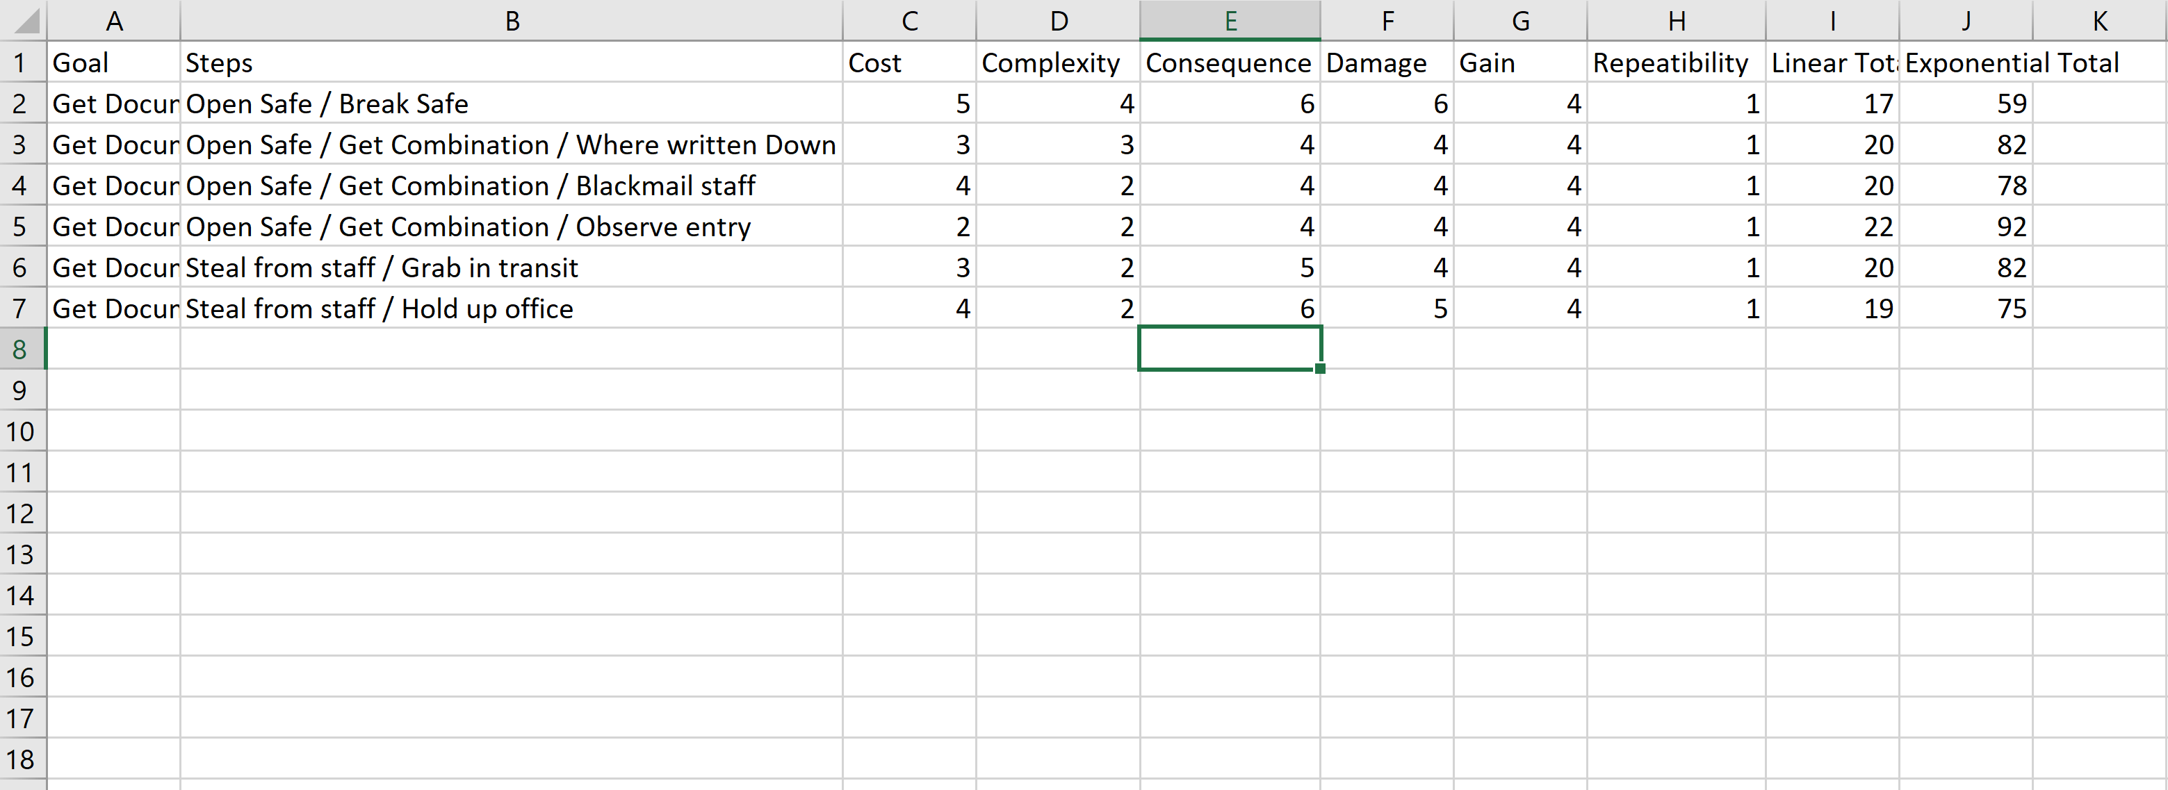

Slide 41
Countermeasures
Guards: 0/0/1/0/0/0
Armed Guards: 0/0/2/0/0/0
CCTV: 0/0/1/0/0/0
Timelock safe: 1/1/0/0/0/0

Slide 42
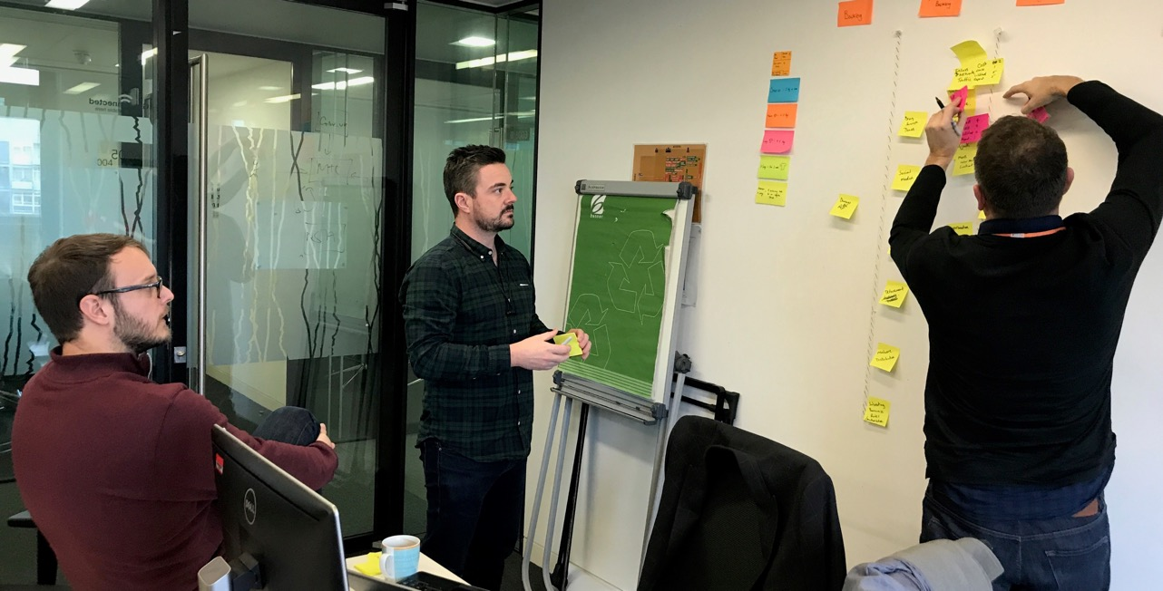

Slide 43
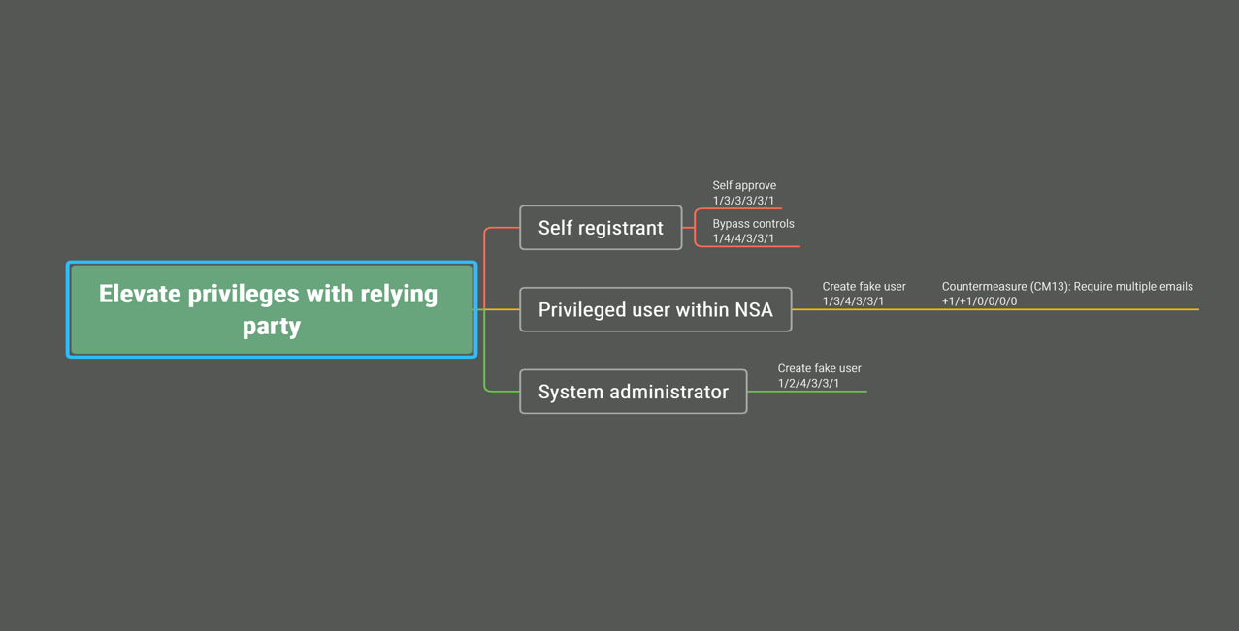

Slide 44
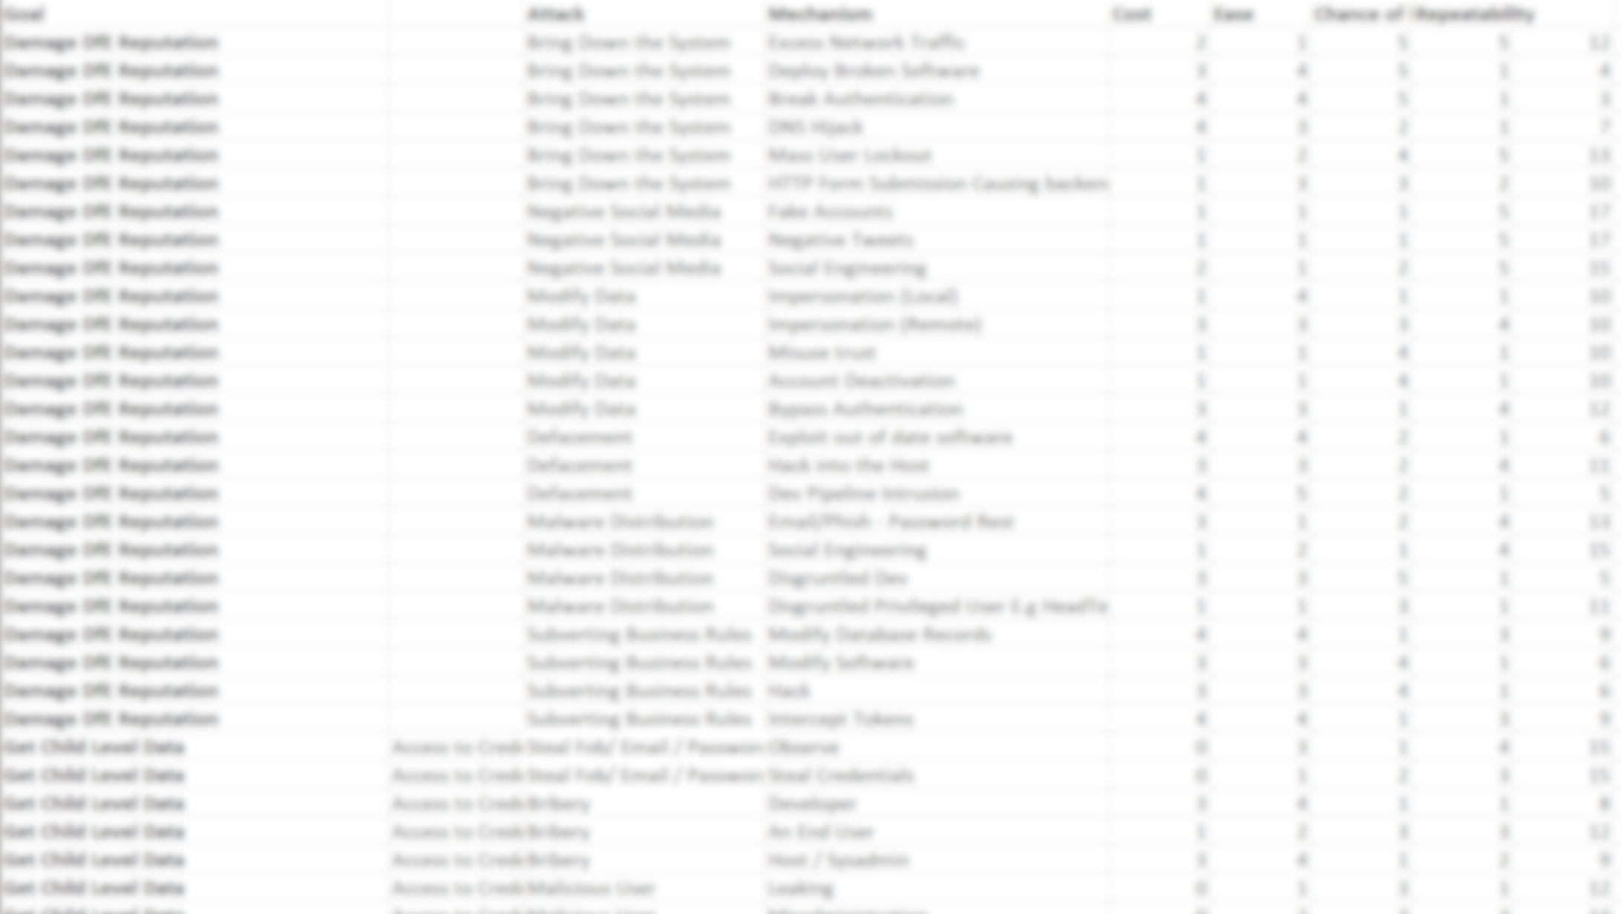

Slide 45
Scope the systems

Slide 46
Kitten Injury Fund

Slide 47
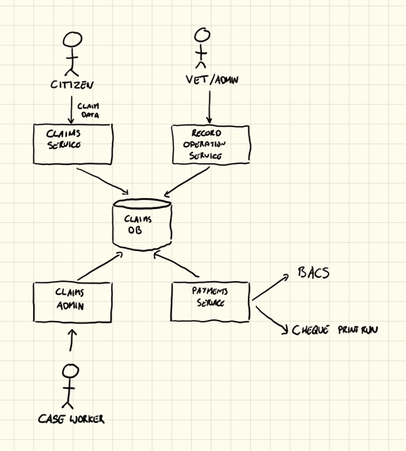

Slide 48
Who are the attackers?

Slide 49

Han Solo
Motivation
Han Solo is motivated primarily by money, but also works with the rebel alliance.
Han is capable of using common tools as well as modifying existing tools on the fly
Han doesn’t want to be caught and so takes an effort to avoid head on confrontations
Capabilities
Resources: 2/5
Capability: 4/5
Bravery: 2/5
Criminal connections: 3/5
Connections
Rebel Alliance, Hutts

Slide 50
Common Anti-personas
Criminals
Hackers
Journalists
Organised Crime
Foreign Powers

Slide 51
Kitten Injury Fund
(in groups, discuss attacker profiles)

Slide 52
Organised Crime
Individual Fraudsters
Hackers
Insiders (Admin staff)
Insiders (Dev Team)
Activist Groups

Slide 53
Fraudsters

Slide 54
What do they want?
(in groups, discuss goals)

Slide 55
Steal user identities
Steal pet details
Steal money
Take down the service
Damage reputation

Slide 56
How will they get in?

Slide 57
How might you achieve the goal

Slide 58
Spoofing
Tampering
Repudiation
Integrity
Denial of Service
Escalation of Privilege

Slide 59
How will they get it?
(in groups, create 1-2 trees)

Slide 60
Understand impact of attacks

Slide 61
Ranking 1-6, often order of magnitude increase

Slide 62
Cost to the attacker
Complexity
Consequences for attacker
Reward to the attacker
Damage to the organisation
How often can it be repeated
Notes:
In groups, assess the trees and present back

Slide 63
Determine countermeasures

Slide 64
Technical
Procedural
Personnel

Slide 65
Prevent
Detect
Correct
Deter
Recover

Slide 66
Agile in action

Slide 67
Product owner owns the tree

Slide 68
Workshop with the entire team*

Slide 69
Visible outputs for the walls

Slide 70
New features assessed against the tree

Slide 71
“Enable faster payments by bank transfer”

Slide 72
“Require 2FA for admin approval of claims”

Slide 73
“Install new firewalls”

Slide 74
Record decisions in wiki

Slide 75
Finally, combine with good baselines of controls

Slide 76
Don’t forget the top 4 tips for cyber security

Slide 77
Patch the OS
Patch applications
Application Whitelisting
Separate admin controls

Slide 78
Review

Slide 79
Define scope of system
Define attackers
Define attacker goals
Elaborate tree for each goal
Evaluate costs and rewards
Consider countermeasures
Iterate

